Slide 1

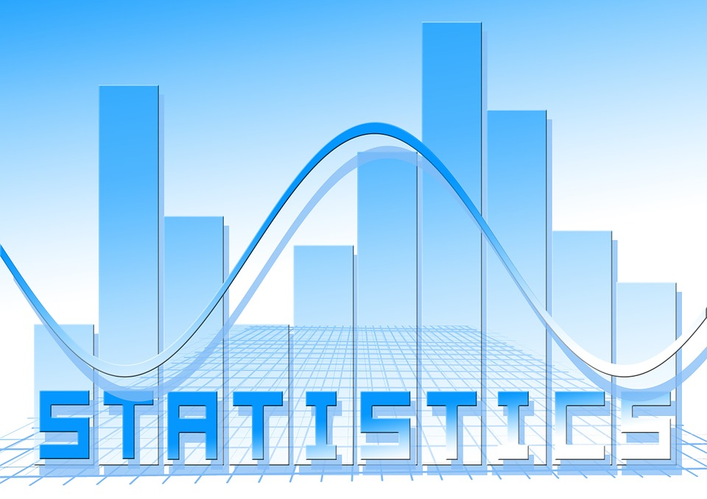
What is Statistics?
Statistics is a mathematical science including methods of collecting, organizing and analysing data in such a way that meaningful conclusions can be drawn from them. In general, its investigations and analyses fall into two broad categories called descriptive and inferential statistics.

Slide 2
Taxonomy of Statistics
Statistical Methods
Descriptive Methods
Inferential Methods
univariate
bivariate
multivariate
applied to means
...to other statistics
shape
correlation
multiple regression
2 groups
center
regression (prediction)
t-test
spread
dep.groups t-test
relative position
ANOVA

Slide 3
Types of Analytics
Descriptive Analysis
KPI dashboards
Monthly revenue reports
Sales leads overview
Predictive Analysis
Statistical Model like AML, Fraud, Sales Forecasting etc. to solve business problems
Prescriptive Analysis
Business processes can be performed and optimized daily without a human doing anything with artificial intelligence

Slide 4
How to develop statistical thinking???

Slide 5
Sample and Population
Infer
Sample
Population
A subset of a population to provide statistical information (inference) about the population
Sample Statistics is used to define it
All members of a defined group that we are studying for data driven decisions.
We often study a sample from that population to infer information about the larger population as a whole
Population parameters are used to define it

Slide 6
Types of sampling
A Simple random sample (SRS) of size n consists of n individuals from the population chosen in such a way that every set on n individuals has an equal chance of being in the selected sample.
Stratified sampling occurs when a population embraces a number of distinct categories and is divided into sub-populations, or strata. At this stage, a simple random sample would be chosen from each stratum and combined to form the full sample.
Cluster sampling divides the population into groups, or clusters. Some of these clusters are randomly selected. Then, all the individuals in the chosen cluster are selected to be in the sample.
Systematic sampling relies on arranging the target population according to some ordering scheme and then selecting elements at regular intervals through that ordered list.

Slide 7

Some more…
Sample
Sample Size
Population
Distribution
Data

Slide 8
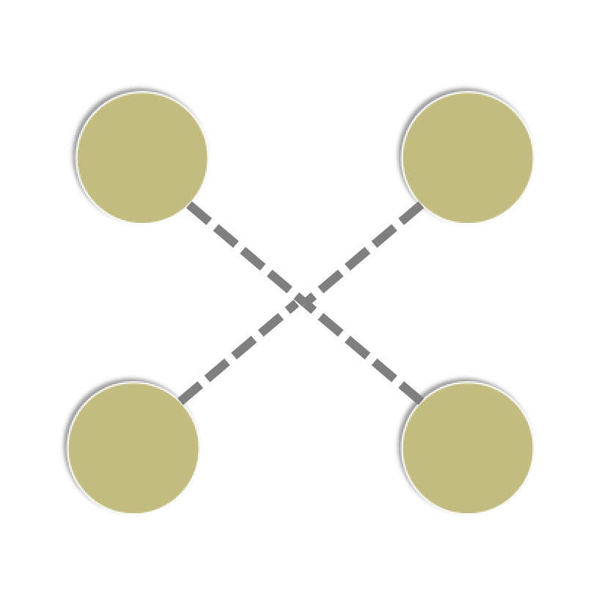
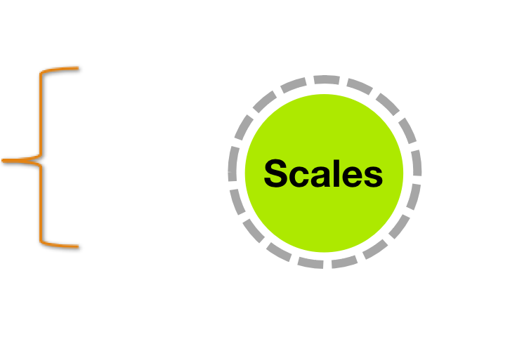

Scales of Measurement
Ratio
Nominal
(Quantitative measures) - Measurement is numeric
(Qualitative measures) - Classify into non-numeric categories
Interval
Ordinal

Slide 9
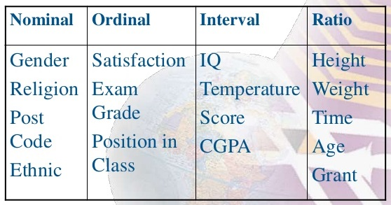
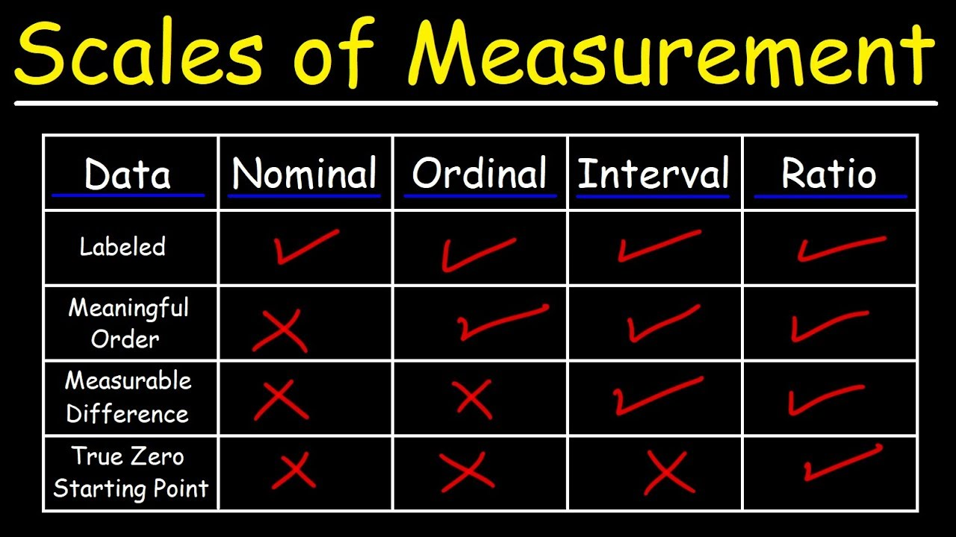
Scales of Measurement

Slide 10
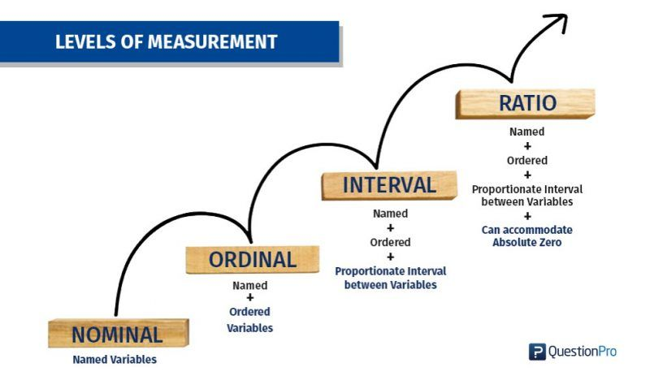
Scales of Measurement

Slide 11
Descriptive Statistics

Slide 12
Descriptive Statistics
Descriptive data can be represented in 3 ways:
Measures of central tendency
Measures of dispersion
Measures of Symmetricity / shape

Slide 13
1. Measures of central tendency
(Mean, Median, Mode)

Slide 14
Introduction
Central tendency measurement is a summary measure of the overall level of a dataset.
Commonly used methods are:
Mean
Median
Mode

Slide 15
Mean
Summing up all the observation and dividing by number of observations.
Arithmatic mid value of any distribution
www.skillslash.com

Slide 16
Example: Find the mean of 4, 5, 7, 2, 8, 10, 1 ?
Solution:
Mean
= (4+5+7+2+8+10+1) / 7
= 37 / 7
= 5.285 (approx.)

Slide 17
2. Median
Median is the value which divides the data in 2 equal parts i.e. number of terms on right side of it is same as number of terms on left side of it when data is arranged in either ascending or descending order.
Note: If you sort data in descending order, it won’t affect median but IQR will be negative.
Physical Mid value of any distribution
www.skillslash.com

Slide 18
Example: Find the median of 4, 5, 7, 2, 8, 10, 1 ?
Solution:
Put in ascending order:
1, 2, 4, 5, 7, 8, 10
Median = mid number (if its odd)
= 5
Note: If it is EVEN, we need to take average of middle 2 numbers.

Slide 19
Example: Find the mean and median of 4, 5, 7, 2, 8, 10, 70000 ?
Solution:
Put in ascending order:
1, 2, 4, 5, 7, 8, 70000
Median = mid number (if its odd)
= 5
Mean= Sum(1, 2, 4, 5, 7, 8, 70000
)/7= 10005.285 (approx.)
Which is reliable?

Slide 20
3. Mode
Mode is the term appearing maximum time in data set i.e. term that has highest frequency.
Example: Find mode of 5, 5, 2, 4, 6, 8, 9?
Answer: 5 (Since 5 is repeated twice)
Note: If there is no repetition of data then mode does not exists.
www.skillslash.com

Slide 21
Business Use Cases
www.skillslash.com

Slide 22
2. Measures of Spread / Dispersion
Standard Deviation, Variance, Range, Percentile, IQR (Inter Quartile Range), Coefficient of Variance

Slide 23
Introduction – Measures of Spread / Dispersion
The measures of central tendency (Mean, Median, Mode) are not adequate to describe data.
Dispersion is a set of measures that helps one to determine the quality of data in an objectively quantifiable manner.
www.skillslash.com

Slide 24
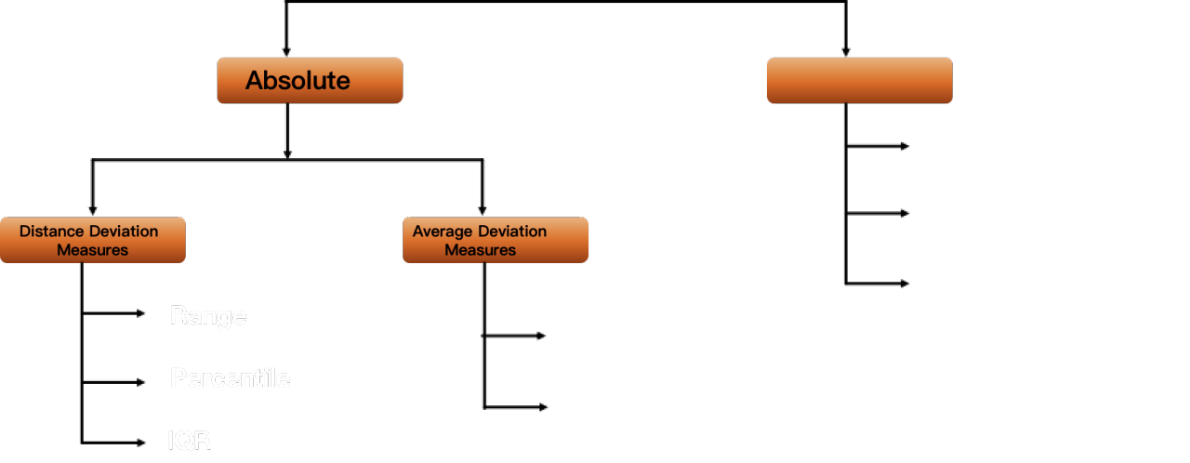
Types of Measures of Spread / Dispersion
Relative
Coefficient of Variation
Coefficient of Standard Deviation
Coefficient of Quartile Deviation
Range
Variance
Percentile
Standard Deviation
IQR

Slide 25
3. Measures of Symmetricity / Shape
Skewness & Kurtosis

Slide 26
Introduction to Measures of Symmetricity
Two measures of central tendency and dispersion are inadequate to characterize a distribution completely.
Measures of symmetricity supports and supplemented by two more measures:
Skewness
Kurtosis
www.skillslash.com

Slide 27
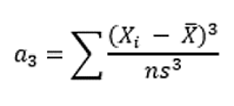
1. Skewness
Skewness is usually described as a measure of a dataset’s symmetry.
Skewness is calculated as:
Where n is the sample size, Xi is the ith X value, X-Bar is the average and s is the sample standard deviation.

Slide 28
Conditions for Skewness
If the skewness is between -0.5 and 0.5, the data are fairly symmetrical.
If the skewness is between -1 and – 0.5 or between 0.5 and 1, the data are moderately skewed.
If the skewness is less than -1 or greater than 1, the data are highly skewed.

Slide 29
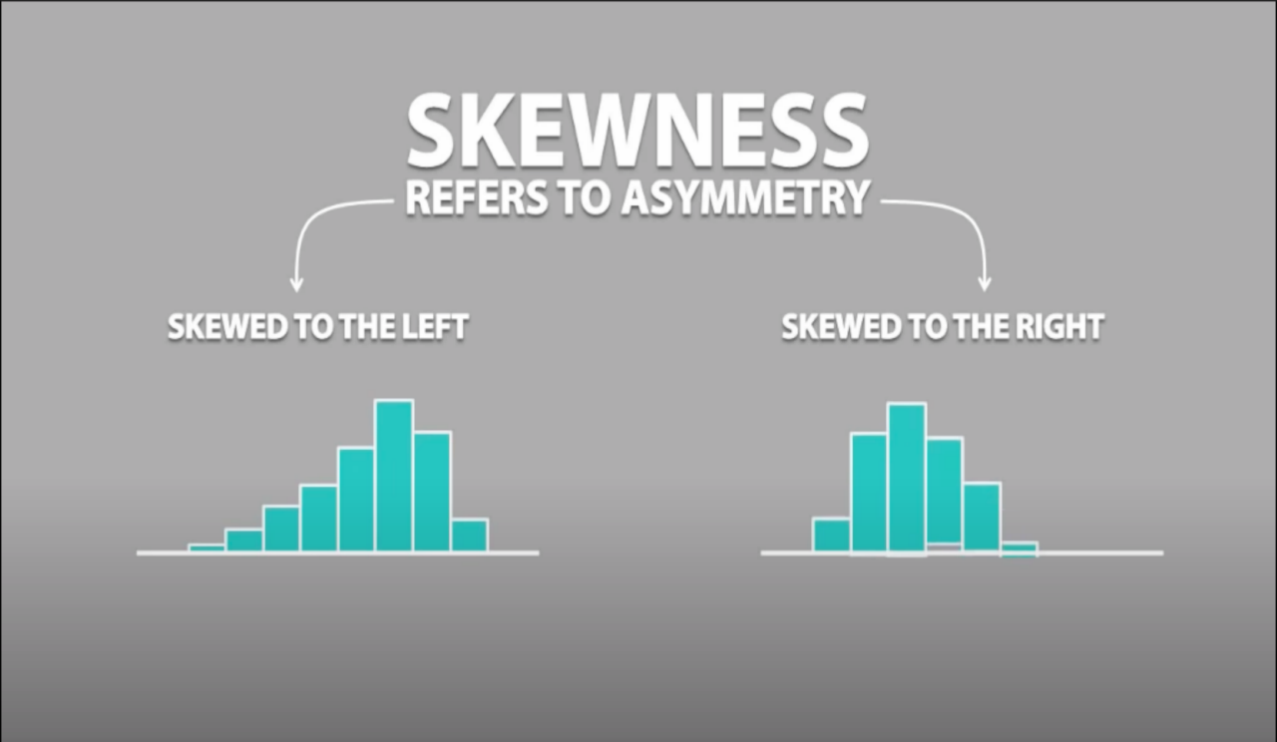

Slide 30
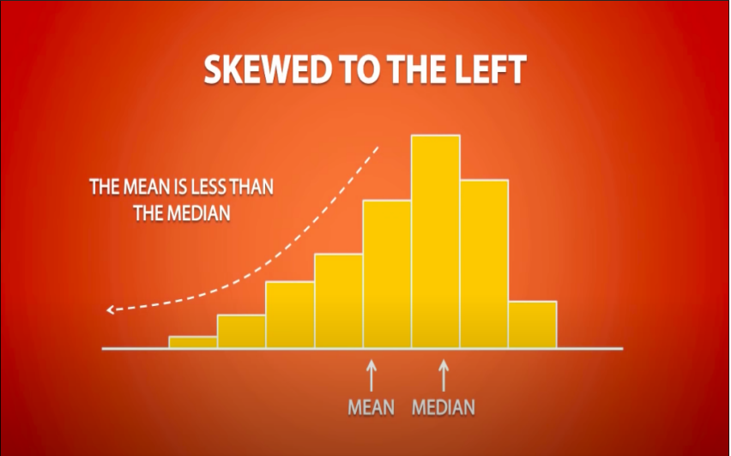
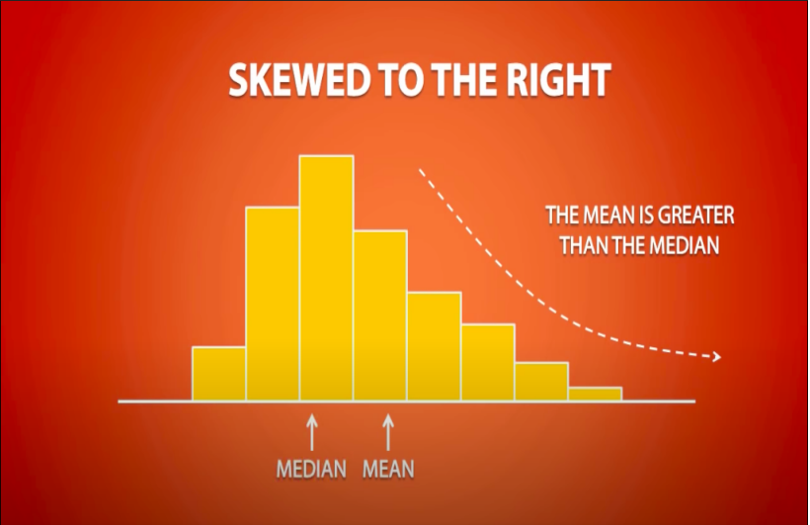

Slide 31

2. Kurtosis
Kurtosis is all about the tails of the distribution – not the peakness or flatness. It measures the tail-heaviness of the distribution.
Kurtosis is calculated as:
Where n is the sample size, Xi is the ith X value, X-Bar is the average and s is the sample standard deviation.

Slide 32
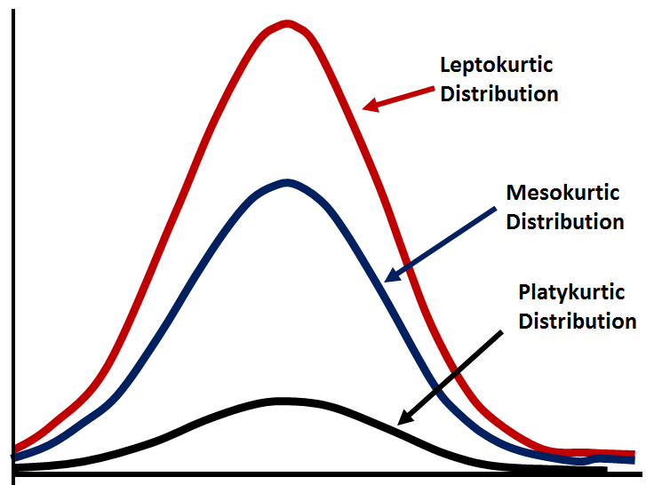
What does the value of Kurtosis tells about the shape?

Slide 33
Relation between Features

Slide 34
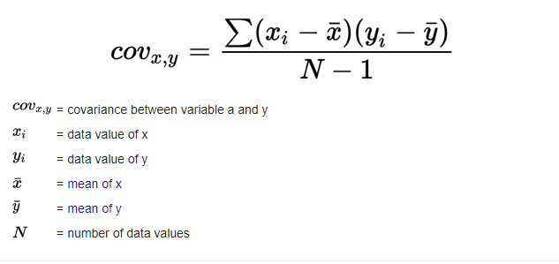
1. Covariance
Covariance is a measure of the joint variability of two random variables, used to determine the relationship between two variables
Covariance is calculated as:

Slide 35
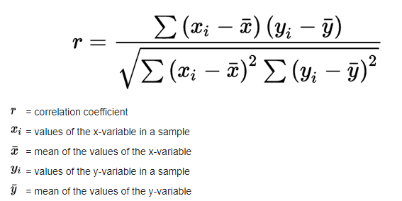

2. Correlation
The Pearson correlation coefficient is used to measure the strength of a linear association between two variables, where the value r = 1 means a perfect positive correlation and the value r = -1 means a perfect negataive correlation

Slide 36
